Slide 1

Hands-on Schedule
Abstractions
Part II: Synthesis
Presenter: Yitian Sun
Synthesis
Tensor
Linalg
ADL Language
Analysis
Apps
Transform
Scheduling
Affine
SCF
Stream
MLIR
Compiler
MemRef
Arith
APS
Part III: Compiler
Presenter: Chenyun Yin
Flexible-levels
Instr. Finding
CMT
Firrtl
Pattern-based
Retargeting
C/C++ Frontend
ML Pipeline
hw
comb
seq
Part I: HDL and Instruction Finding
Presenter: Youwei Xiao
Architecture
Circuit
Interconnect
Memory System
GAA abstraction
Dyn pipeline
HDL Elaboration
Task Scheduler
Part IV: Arch and Deployment
Presenter: Yuyang Zou
EDA Backends
Simulation
Synthesis
Phys. Impl.
FPGA Deployment

Slide 2
Setup
Login our server
First, you need a SSH key
check if your SSH directory exists
win: C:\Users\<username>/.ssh
linux: $HOME/.ssh
mac: /Users/<username>/.ssh
if not exists, create one
reference link
# Windows, open PowerShell
ssh-keygen -t ed25519 -C "<email>"
# Linux, open terminal
ssh-keygen -t ed25519 -C "<email>"
# Mac, open terminal
ssh-keygen -t ed25519 -C "<email>"
SSH public key can be found in <SSH>/id_ed25519.pub

Slide 3
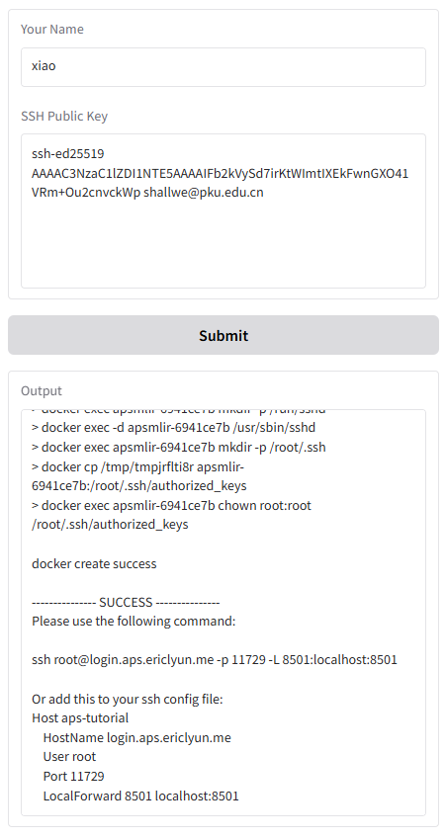
Setup
Login our server
https://login.aps.ericlyun.me
Enter your name and ssh key
Follow the output to connect

Slide 4
Setup
Login our server
https://login.aps.ericlyun.me
Enter your name and ssh key
Follow the output to connect
Here is the SSH command for connection

Slide 5
Setup
Login our server
You can use PowerShell/terminal
Or, you can use VSCode
Ctrl-Shift-P / ⇧⌘P, type Remote: Show Remote Menu
select SSH to install the extension
Ctrl-Shift-P / ⇧⌘P, type Remote-SSH: Open SSH Configuration File
paste
Ctrl-Shift-P / ⇧⌘P, type Remote-SSH: Connect to Host
pick “aps-tutorial”; pick “Linux”, “Yes”; wait for success
Here is the SSH configuration to be copied

Slide 6
Setup
Login our server
You can use PowerShell/terminal
Or, you can use VSCode
Where are the demos?
Ctrl-J / ⌘J to open a terminal, run “ls root”, you can see “aps” and “cmt2”
Open the folder?
Ctrl-K+O / ⌘K+O, select “/root/” and open
Now we are ready to start the hands-on session!

Slide 7
Outline
HDL
What is Cement?
Cmt2 basics and examples
Circt-cmt2
Instruction finding
ISAMORE (ASPLOS’26)
finding reusable instructions via e-graph anti-unification

Slide 8








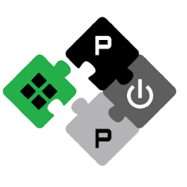
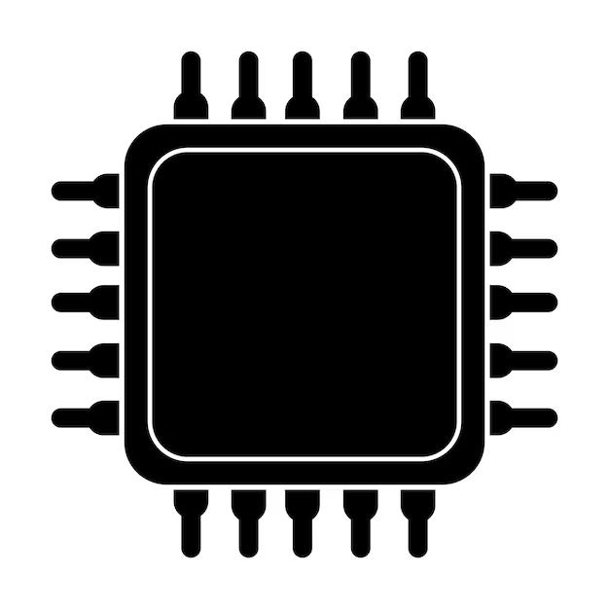

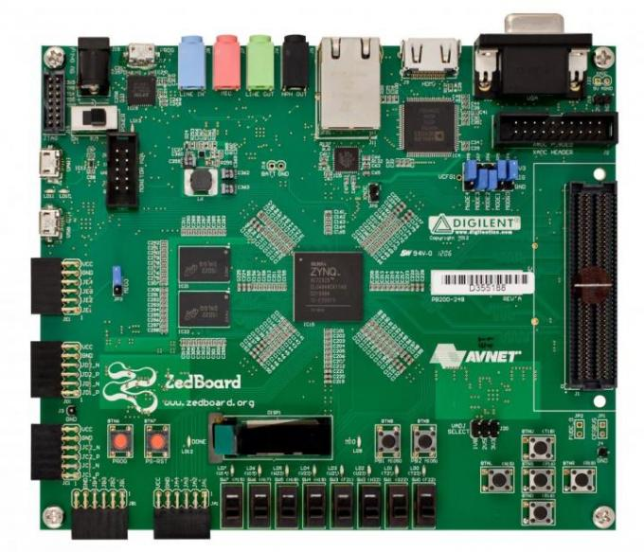
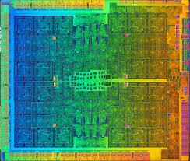
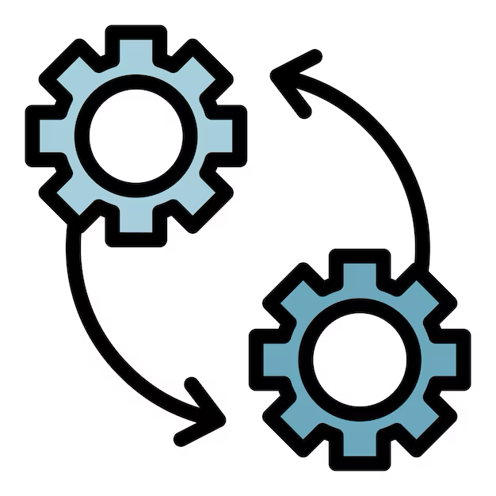

Position of HDL in APS Flow
Domain Applications
Base Processors
Rocket
BOOM
CVA6
CV32E
ISAX MLIR
ISAMORE
APS
Frontend
APS
Synthesizer
Cement CIRCT
Processor
RTL
.cadl
RTL
Cross-level
ISAX Description
APS
Compiler
FPGA
Flow
ASIC Flow
Software
Hardware

Slide 9
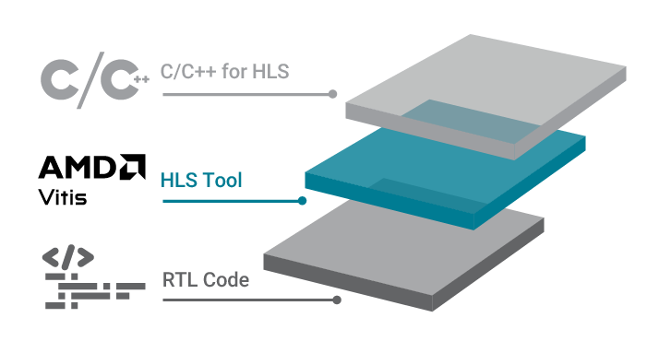



Cement: Better HDL and Framework for Chip Design
Traditional HDL
tedious hardware code
Embedded HDL (eHDL)
design hardware in advanced programming language (Scala, Python)
?
HLS: design hardware in C/C++
Cement (cmt2!)
Rust-embedded HDL
software-like control description
keep evolving…
Cement (cmt1)
published at FPGA’24
rule-based design
Youwei Xiao, Zizhang Luo, Kexing Zhou, and Yun Liang. 2024. Cement: Streamlining FPGA Hardware Design with Cycle-Deterministic eHDL and Synthesis. FPGA '24. https://doi.org/10.1145/3626202.3637561
High-level HDL: describe hardware as rules
Notes:
we are going to introduce Cement, which serves as an HDL (Hardware Description Language) and a framework for chip design. Cement has now evolved into its second - generation version, namely cmt2.
When it comes to traditional HDLs, which are most commonly used, designers are often required to write intricate and cumbersome hardware code. Embedded HDLs, such as Chisel, offer the advantage of enabling the construction of hardware using advanced programming languages. Meanwhile, High - Level Synthesis (HLS) can synthesize C/C++ functional descriptions into hardware.
The first - generation of Cement, cmt1, was presented at FPGA'24. It combines the advantages of embedded HDLs (ehdl) and HLS, and is implemented by embedding into the Rust language. As Cement continued to evolve, a rule - based hardware description feature was added, thus giving rise to the second - generation version, cmt2.

Slide 10
Today, we introduce cmt2!
as the successor of …
Cement (cmt1)
published at FPGA’24
Rust-embedded HDL
cmt2!
rule-based design
software-like control description
Notes:
Today, our focus is on cmt2. The core of cmt2 lies in three key characteristics: Rust - embedded HDL, rule - based design, and software - like control description.
In the following part, we will demonstrate the hardware programming methods of cmt2 and illustrate its features through practical examples.

Slide 11

Cmt2 is natively in Rust, because…
Rust has been the top admired programming language for 7 consecutive years
In our own experience, it’s powerful, efficient, user-friendly
Rust is admired by 82.2%!
Notes:
First of all, let's discuss why we chose Rust as the high - level language to embed in Cement. Rust has been ranked as the "top admired programming language" for seven consecutive years. In 2024, an astonishing 82.2% of developers expressed their admiration for Rust, leading far ahead of other languages.
This widespread admiration is not without reason. Rust's unique features contribute to its popularity. From our own experience, Rust is indeed a remarkable language. It's powerful, efficient, and very importantly, has user-friendly ecosystem, including compiler, build system and package manager.

Slide 12
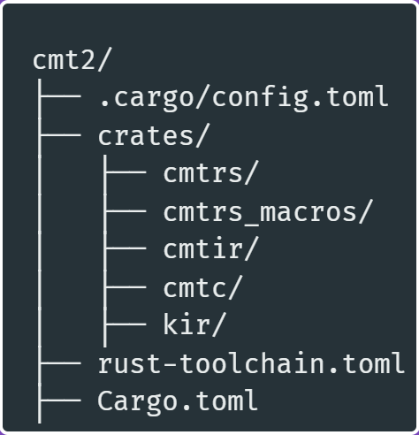
In Rust, cmt2 project looks like…
cd /root/cmt2 && ls –a
include necessary build flags
cmtrs eHDL
Here, 5 library crates forms the cmt2 package
cmtir IR
kir
cmtc
compiler
backends
specify rust version
specify package information and dependencies
Notes:
Now, let's take a look at the code file structure of the cmt2 project. Let's run the command "cd /root/cmt2 && ls -a" together to view the files included in the cmt2 project. Here, we can see three files. One of them contains the build flags for Rust compilation. Another file is used to declare the Rust version. The third file declares the package information and package dependencies.
In addition, the implementation of cmt2 consists of five library crates. The cmtrs is the implementation of eHDL. It is transformed into the cmtir IR which is based on kir. Eventually, this IR is converted into multiple backends, including SystemVerilog and diverse simulation workspace. The cmtc compiler, on the other hand, realizes the transformation between different components as well as different backends.

Slide 13
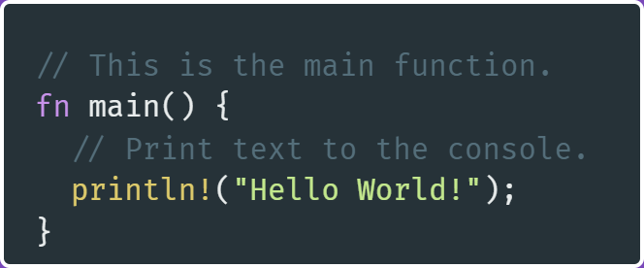
Hello Rust World!
touch /root/cmt2/crates/cmtc/examples/hello.rs
create hello.rs file ↑
click [run] above fn main, or …
under directory /root/cmts
Cargo is Rust’s build system and package manager. It’s easy-to-use!
More user-friendly than sbt for Scala/Chisel!
cargo run --example hello
Notes:
Now, let's start creating Rust code. First, we execute the command "touch /root/cmt2/crates/cmtc/examples/hello.rs" to create the hello.rs example file. In this file, we'll write a simple main function, as shown on the left.
Then, we run it. In the terminal, we type "cargo run --example hello". As a result, we can see "Hello, world!" displayed in the terminal. Here, cargo is Rust's build system and package manager. It's designed to be very user - friendly.

Slide 14
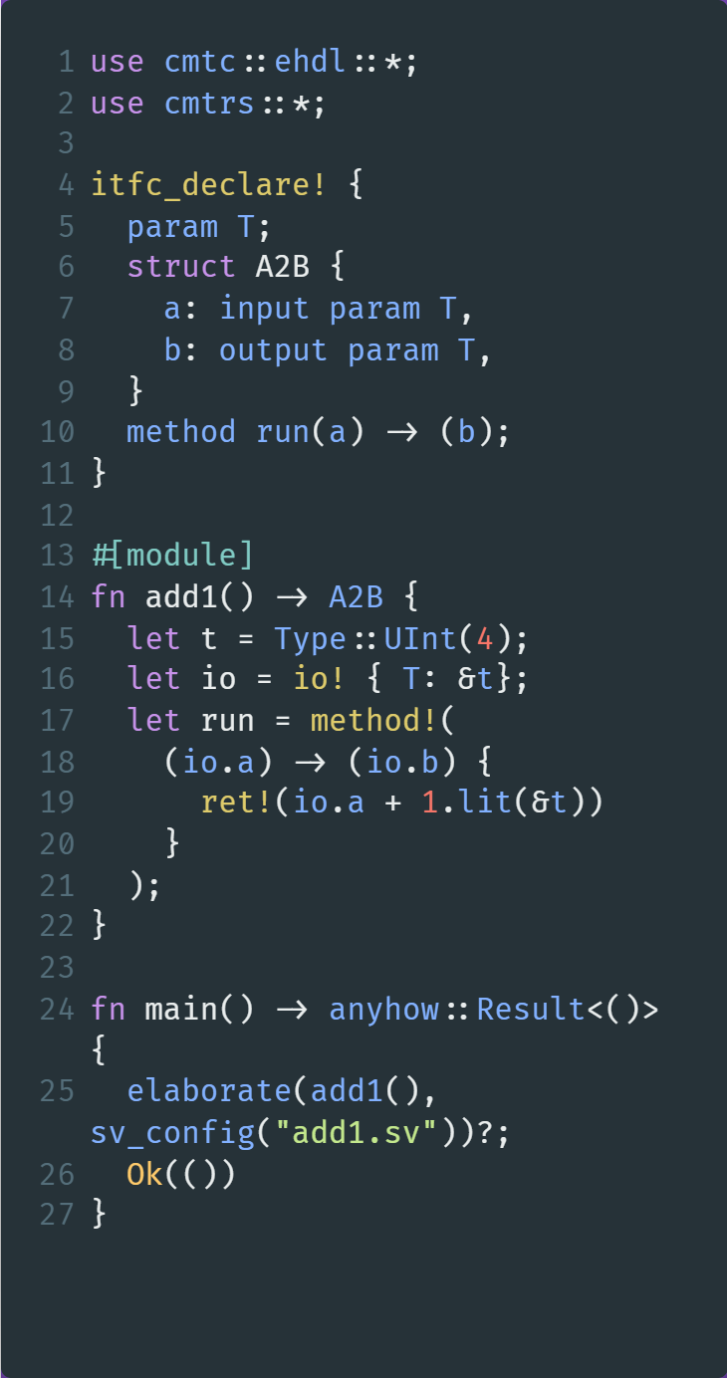
Hello cmt2!
at the top of hello.rs
use clauses import cmt2’s eHDL and compiler features
itfc_declare! is a macro
macro in Rust transforms code at the token-level
Notes:
Now, let's create the cmt2 hello world example. In the hello.rs file, we input the following code which declares a module signature or interface named A2B:
use cmtc::ehdl::*;
use cmtrs::*;
use cmtrs::stl::*;
itfc_declare! {
param T;
struct A2B {
a: input param T,
b: output param T,
}
method run(a) -> (b);
}
The use statements import the eHDL and compiler functionality implemented by cmt2. The itfc_declare! is a Rust macro. In Rust, macros transform code at the token-level, which means they can operate on the source code tokens before compilation and generate more complex or repetitive code based on the given patterns.
If you are interested in what this macro does, you can try to execute the following instruction (requiring network connection) to see the code transformed by the macro.

Slide 15
Hello cmt2!
at the top of hello.rs
macro is an advanced feature in Rust!
Please leave cmt2 developers to suffer😂
and… just use them!😁
The left code creates …
A module interface named A2B;
It has one input port a, one output port b, both of which have type T.
It exposes a method run for external world to invoke!
A2B
a:T
method run
b:T
Notes:
Certainly, macros in Rust are an advanced feature. As users, you can simply utilize their functionality without delving into their implementation details.
The code on the left creates a module interface named A2B. This interface encompasses two ports: an input port a and an output port b, both of which have the data type T. Here, T serves as a parameter. This parameter can take on various widths, providing flexibility in the design. This interface exposes a run method to the outside world.

Slide 16
cmt2 is rule-based HDL
at the top of hello.rs
A2B
a:T
method run
b:T
cmt2!
rule-based design
Hardware logic is organized as rules – the execution unit!
Don’t be afriad!😁
Just consider one rule as a group of operations that execute together
In cmt2, we have two types of rules: method rules and always rules:
method rule need to be invoked (Bluespec method)
always rule runs actively (Bluespec rule)
Notes:
As mentioned earlier, a significant feature of cmt2 is its rule - based hardware design approach. In cmt2, the hardware logic is organized as rules, where each rule serves as the smallest execution unit. Don't be intimidated by this concept. Simply think of a rule as a set of operations that execute simultaneously.
To be very brief, cmt2 has two types of rules: method rules and always rules. The key difference between them lies in how they are executed. Method rules need to be invoked for execution. On the other hand, always rules execute proactively. Here, we don’t introduce more details.

Slide 17
cmt2 is rule-based HDL
following itfc_declare!
fn starts a function!
The #[module] macro transfoms the function add1 to create a module of the interface A2B
UInt(4)
add1 of
A2B
a:T
method run
b:T
b=a+1
Now, types are given, rules are filled -- Module is completely described!
Notes:
Right after the itfc_declaration, we proceed to write the specific implementation of the module. Here, the fn keyword in Rust initiates a function. The #[module] macro above it transforms this function into a module implementation for the A2B interface:
#[module]
fn add1() -> A2B {
let t = Type::UInt(4);
let io = io! { T: &t};
let run = method!(
(io.a) -> (io.b) {
ret!(io.a + 1.lit(&t))
}
);
}
We feed an unsigned integer with a width of 4 to the type parameter T in the A2B interface. Then, we describe the logic of the run method: performing an increment operation. With these steps, we've successfully created a complete hardware module.

Slide 18
cmt2 generates SystemVerilog
following fn add1
The new main function to call elaborate for the add1 module
click [run] above fn main, or …
cargo run --example hello
cat add1.sv
Notes:
Next, we'll use cmt2 to transform the add1 module into SystemVerilog. First, we write a new main function. In this function, we call the elaborate function. We need to provide an SV configuration that includes the target file path.
fn main() -> anyhow::Result<()> {
elaborate(add1(), sv_config("add1.sv"))?;
Ok(())
}
After writing this code, in the terminal, we run the command cargo run --example hello. Once the process is complete, we can view the generated SystemVerilog code by running cat add1.sv.

Slide 19
Show features by examples
as the successor of …
Cement (cmt1)
published at FPGA’24
FIR
GEMM
Rust-embedded HDL
cmt2!
rule-based design
software-like control description
Notes:
So far, we've explored the simplest example of using cmt2 to describe hardware. Now, we're going to take a deeper dive and showcase the three core features of cmt2 more comprehensively through two larger - scale examples: FIR (Finite Impulse Response filter) and GEMM (General Matrix Multiplication). This part will be introduced by my colleague Zizhang Luo.

Slide 20
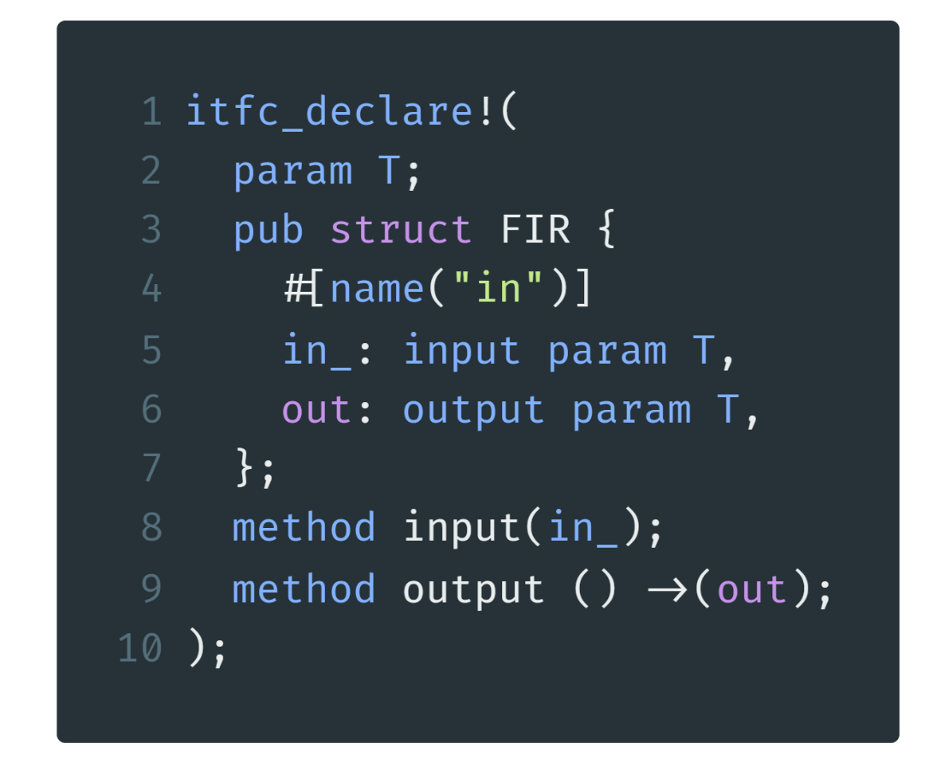
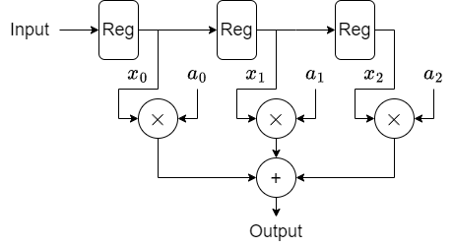
Finite Impulse Response
cmt2!
Rust-embedded HDL
Name of Interface/Module
Type Parameter
An input port
named “in_”
of type T
rename
A method to input data
A method to output data
./crates/cmtc/examples/fir.rs line 7-16

Slide 21
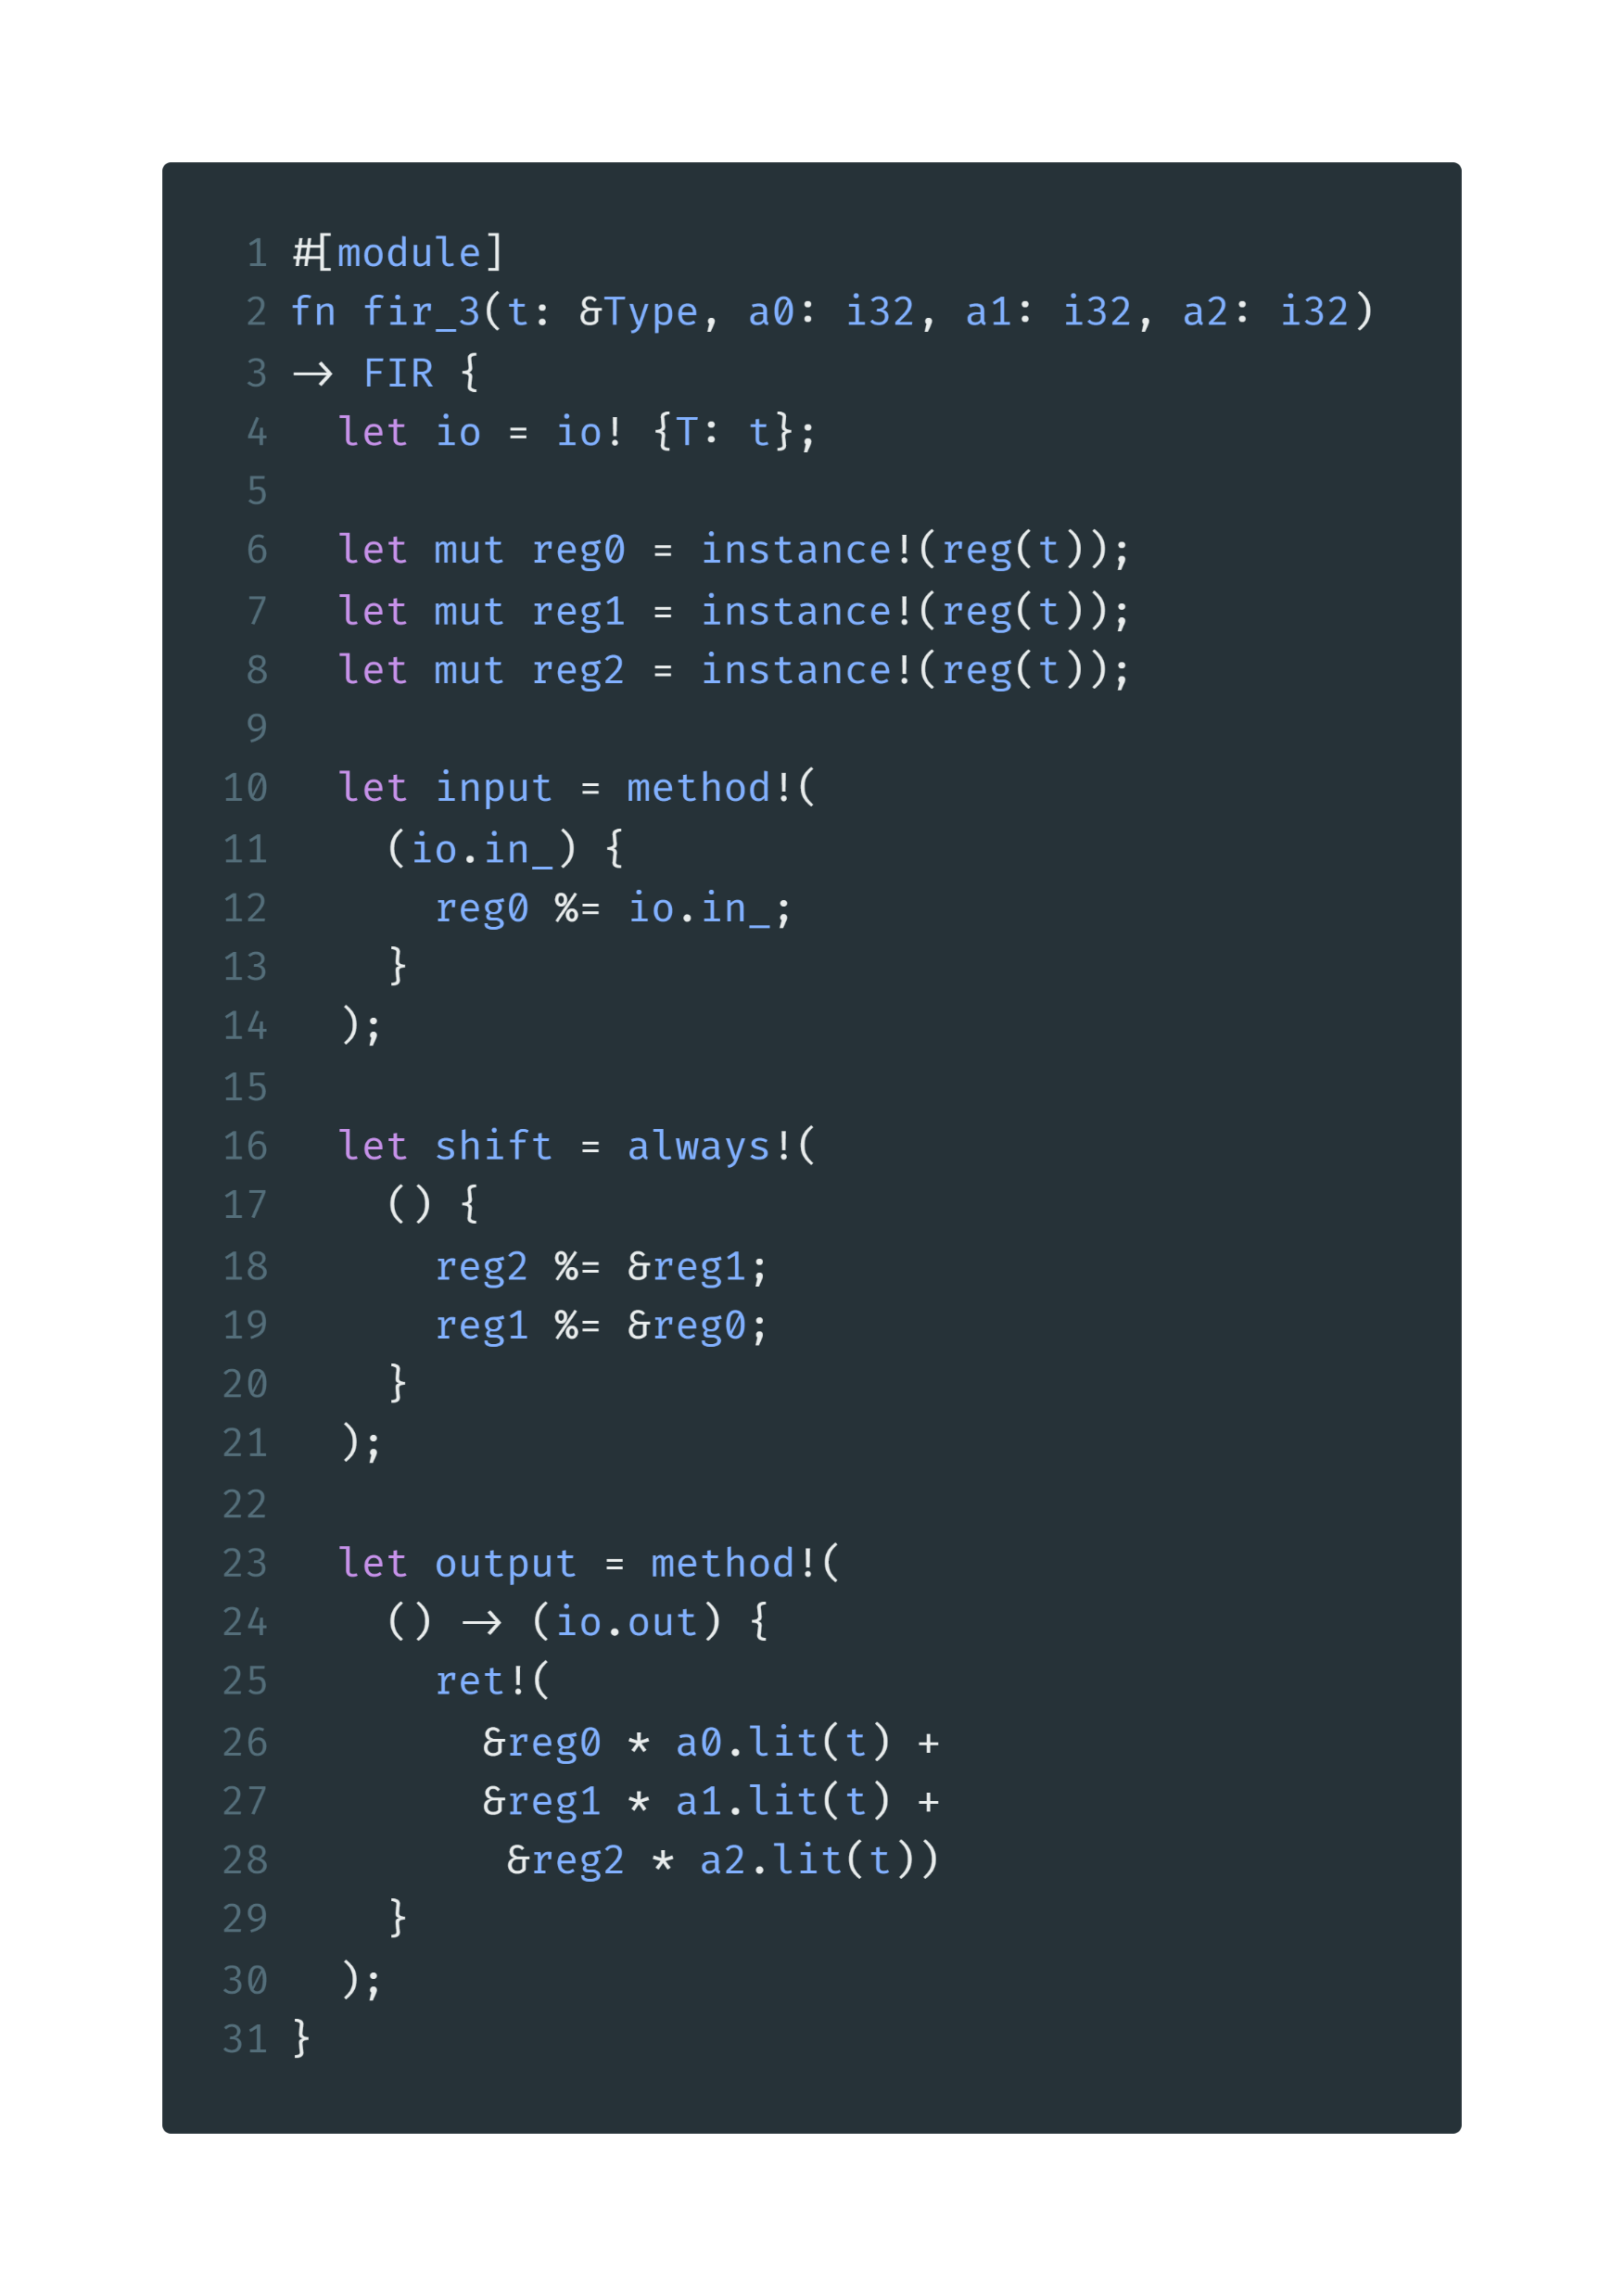
FIR Example1: fixed length
Parameters: type & coefficients
Return a module with interface type FIR
io! macro provides parameters and gets an io struct
instantiate a
Reg as submodule
implement a method
called “input”
input of the method
things to do after the method is invoked
reg %= xx is a syntax sugar for reg.write(xx)
rule-based design
./crates/cmtc/examples/fir.rs line 18-46

Slide 22
FIR Example1: fixed length
implement an always rule called “shift”
shift the registers
implement the output method
return an expression
calculate FIR
convert software value a2 into hardware literal of type t
./crates/cmtc/examples/fir.rs line 18-46

Slide 23
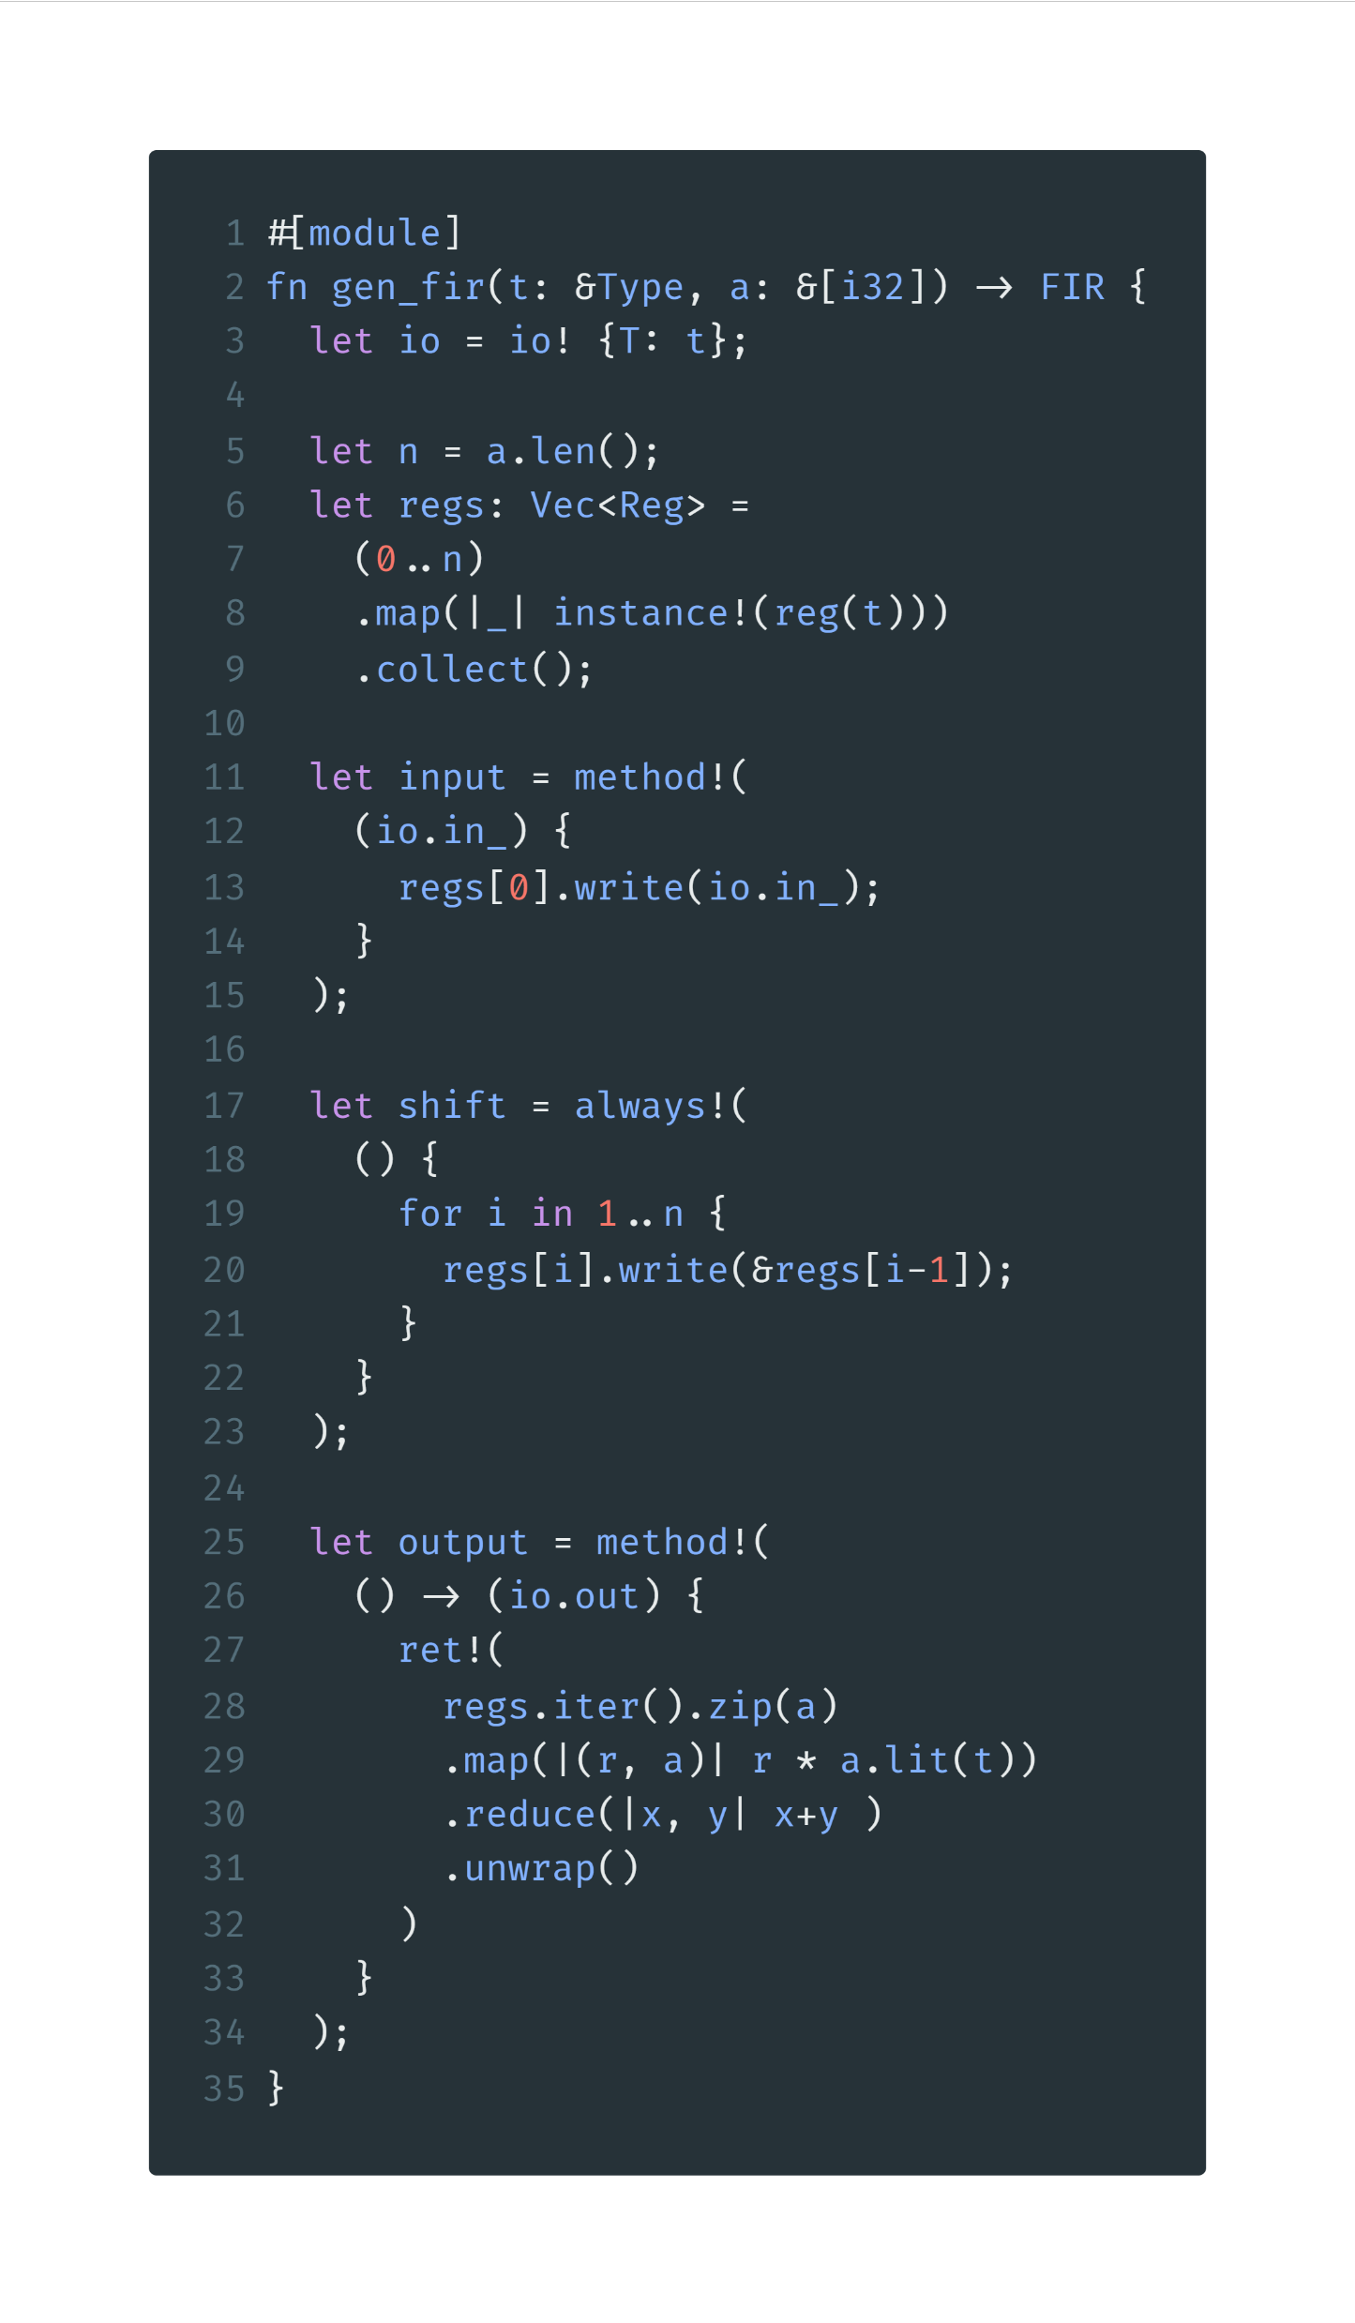
FIR Example2: arbitrary length
An array of coefficients
Still returns FIR
Instantiate
a vector of
Regs
Input to the first reg
Rust-embedded HDL
./crates/cmtc/examples/fir.rs line 48-78

Slide 24
FIR Example2: arbitrary length
Generate n-1 shifts with a software for expression
Make a multiply accumulate expression with functional programming
./crates/cmtc/examples/fir.rs line 48-78

Slide 25

Explanation on the last expression
For audiences that are not familiar with functional programming
regs
a
map()
zip()
reg0
$$×$$
a0
reg1
$$×$$
a1
$$+$$
reg2
$$×$$
a2
$$+$$
reduce()
reg3
$$×$$
a3
$$+$$
Rust-embedded HDL
iter()
Option<Sum>
unwrap()
Sum

Slide 26
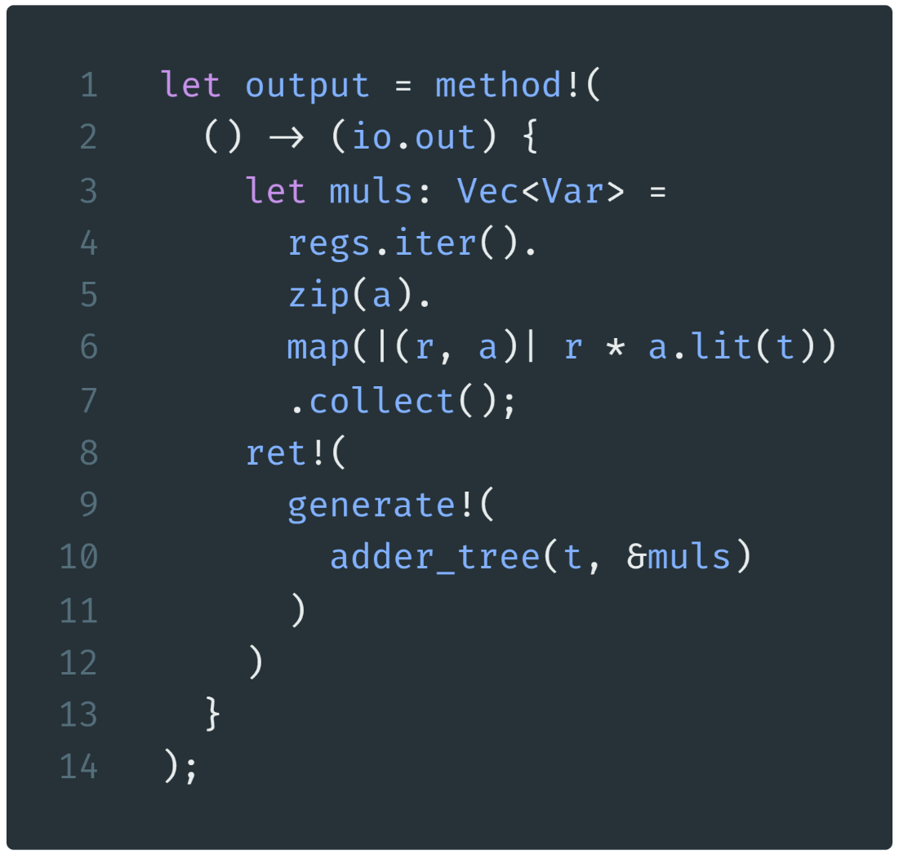
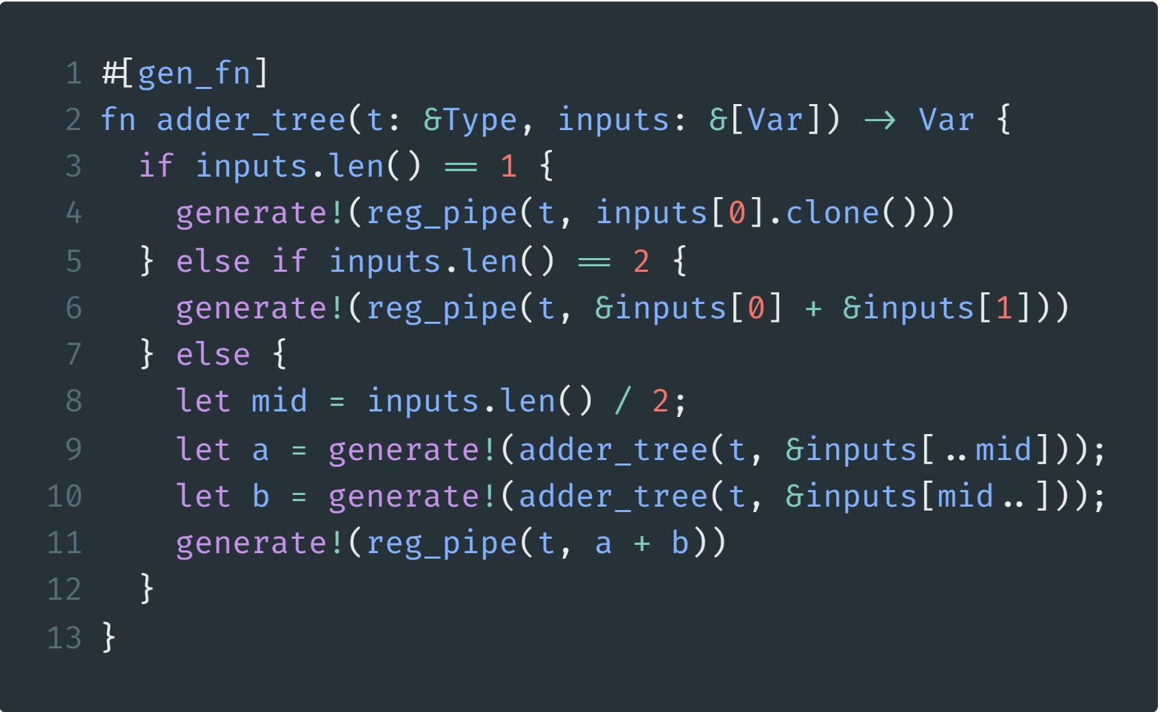
FIR Example3: adder tree
collect multiply results
a gen_fn generates hardware
Variables that will be added
The returned sum
generate one pipeline reg
generate one pipeline reg
for the sum
generate an adder tree
recursive to calculate the left part and the right part
generate one pipeline reg
for the sum
./crates/cmtc/examples/fir.rs line 83-123

Slide 27
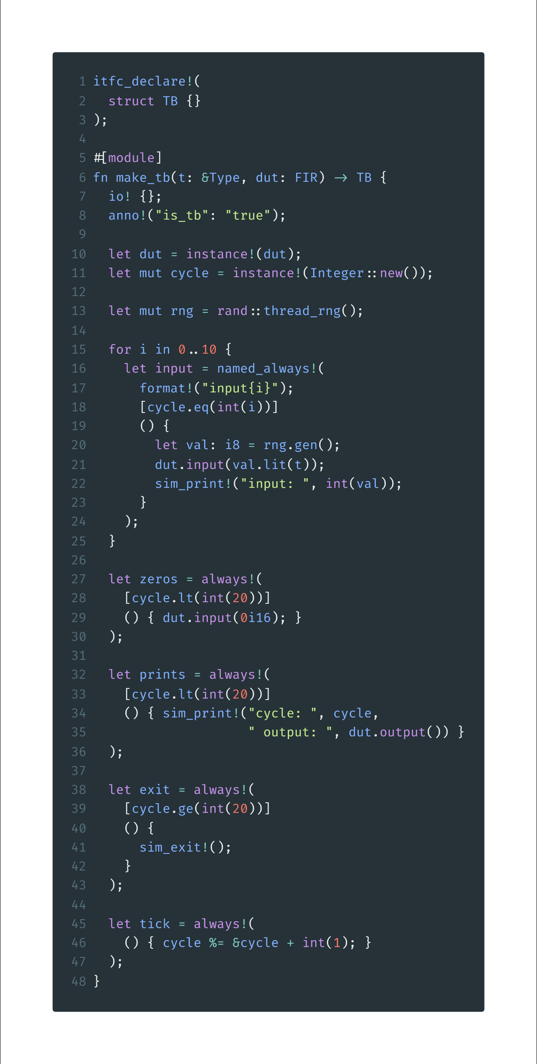
FIR Example: Testbench preparation
the interface for the testbench
pass the DUT into the TB
tell the compiler this is a TB
instantiate DUT
a cycle counter for simulation
a rust random generator
./crates/cmtc/examples/fir.rs line 132-174

Slide 28
FIR Example: Testbench inputs
make 10 inputs
make 10 always rules with different name
rule guard
generate an input,
call method
print the input
./crates/cmtc/examples/fir.rs line 132-174

Slide 29
FIR Example: Testbench inputs
rule guard
print during simulation
call method
finish simulation at cycle 20
increase cycle counter
./crates/cmtc/examples/fir.rs line 132-174

Slide 30
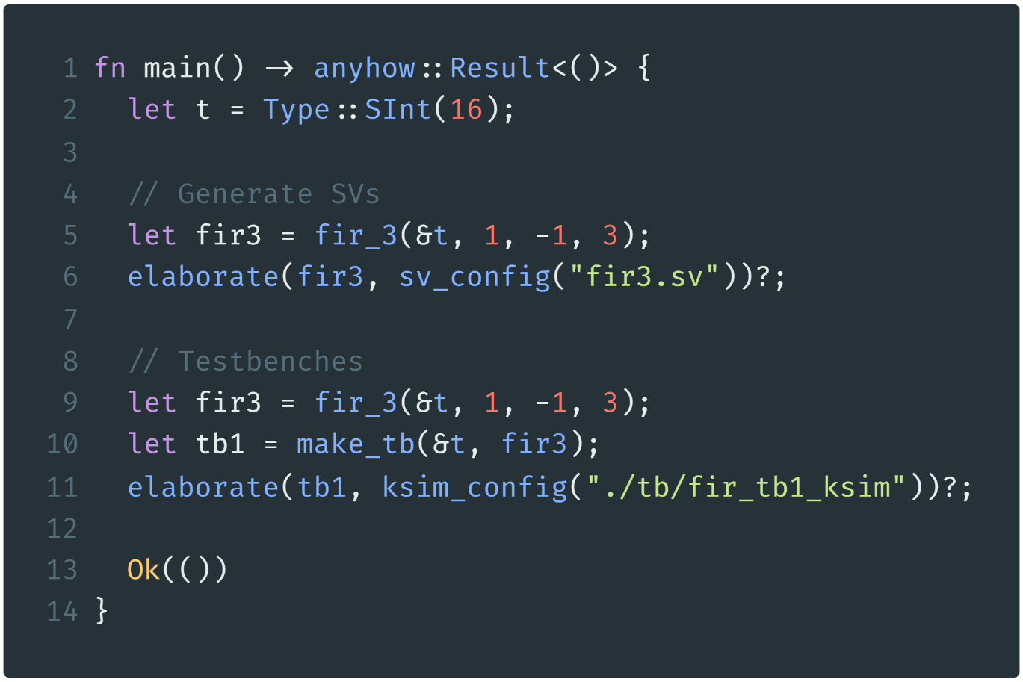
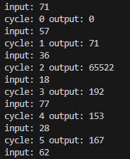
FIR Example: Elaboration & Simulation
main function of Rust
cd /root/cmt2
cargo run –-example fir
cd ./tb/fir_tb1_ksim
make all
./FIR_s6
run Rust
Type: 16-bit signed int
run Khronos
Generate a FIR (first example)
run the simulation program
Elaborate to generate SV
Generate a TB
(FIR is regenerated here)
Elaborate to generate Khronos simulation environment
./crates/cmtc/examples/fir.rs line 176-204
Possible Outputs

Slide 31
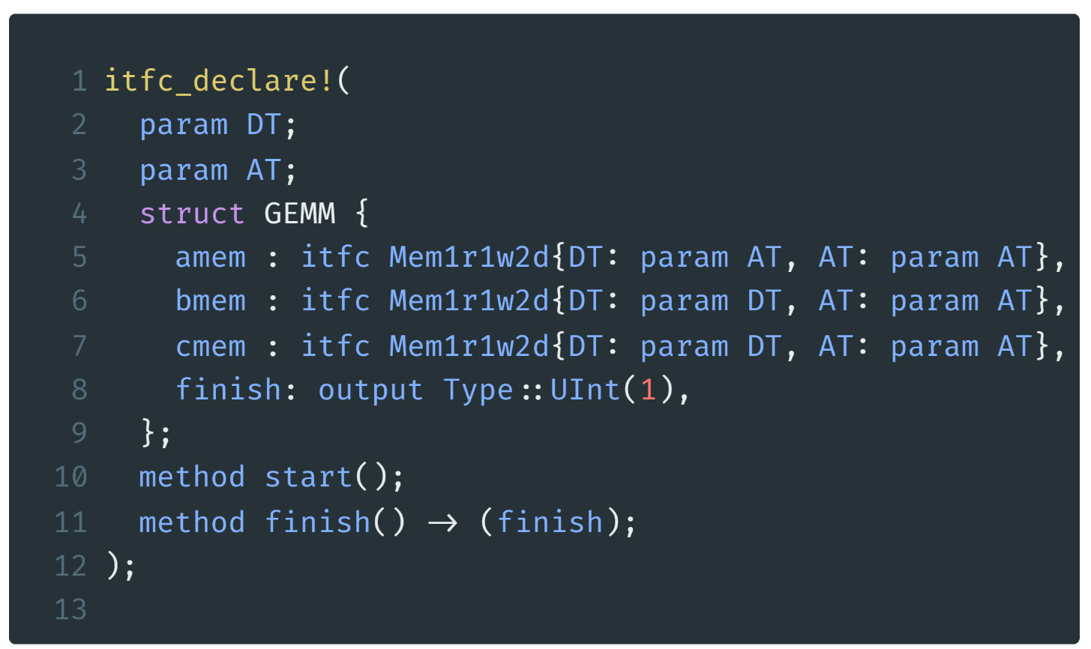
General Matrix Multiplication
cmt2!
write()
software-like control description
A Mem
GEMM
read()
data type
address type
memory as nested interface
B Mem
$$×$$
F
S
M
$$+$$
MAC
simple methods to start computation and report finish
C Mem
./crates/cmtc/examples/gemm.rs line 25-36

Slide 32
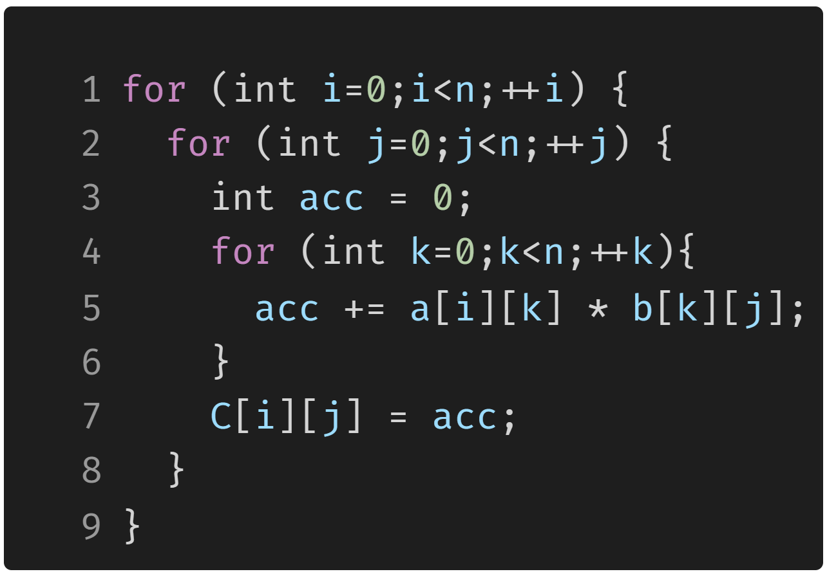
GeMM Example: Software
k
A
k
B
C
j
i
GeMM in C using three for-loops

Slide 33
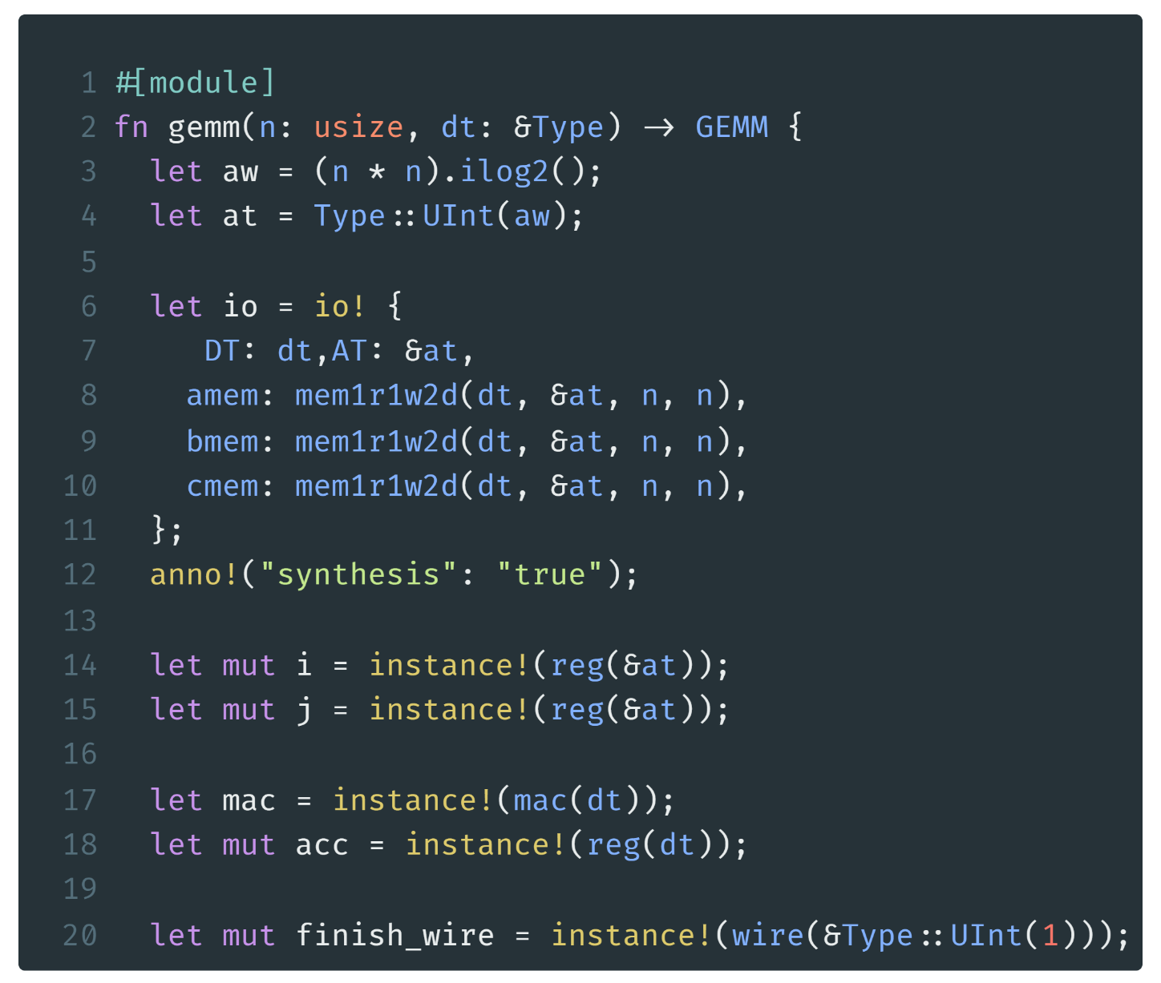
GeMM Example: Preperation
calculate the address type
provide the memory instances to the interface
some register for loops
one MAC unit
one accumulator
./crates/cmtc/examples/gemm.rs line 38-97

Slide 34
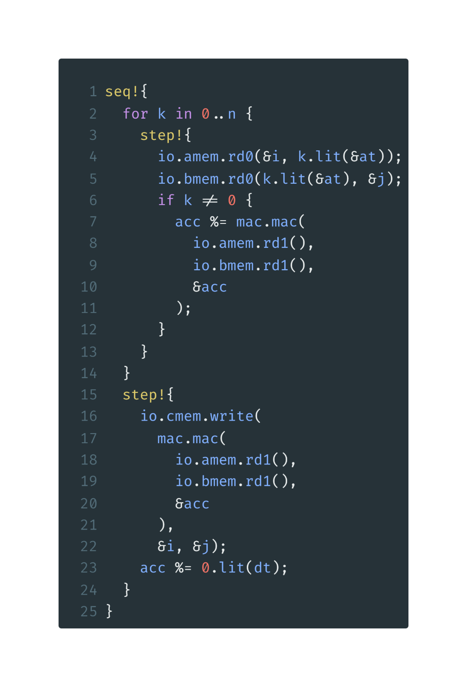
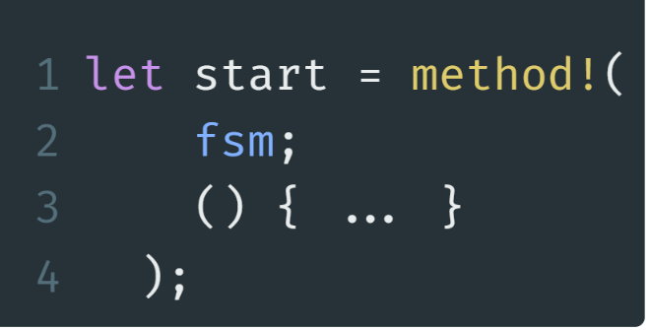
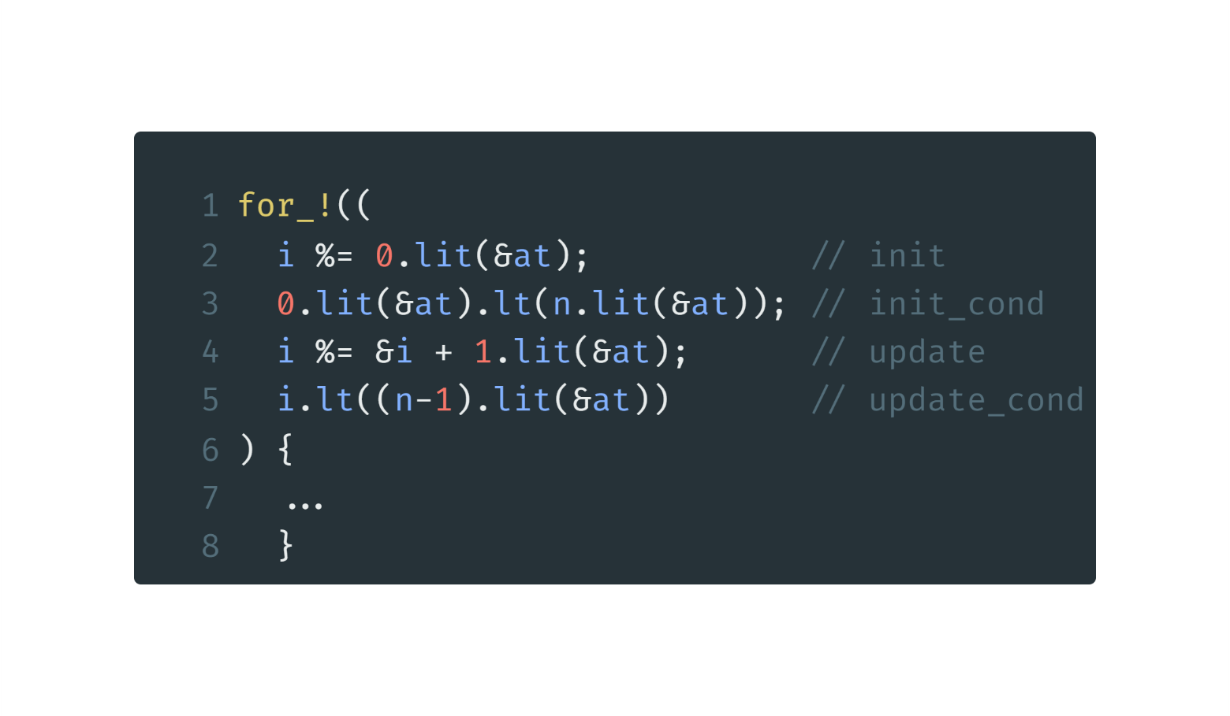
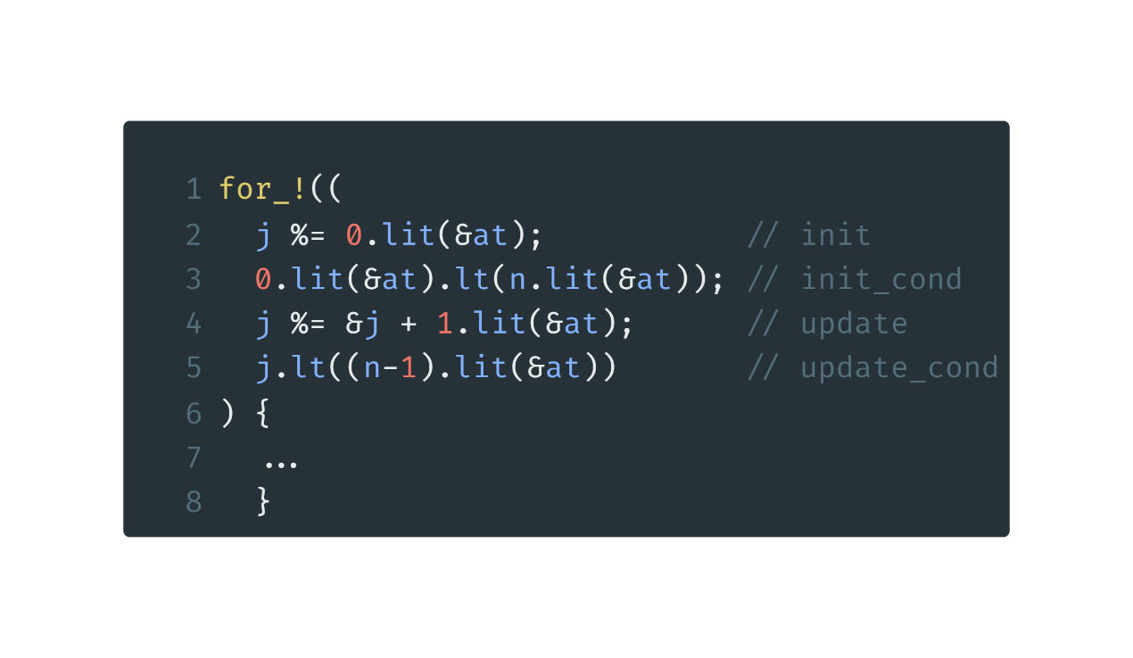
GeMM Example: FSM
software-like control description
keyword
i= 0 to n-1
a for loop
init: i=0
i<n i=0 => 0<n
update: i=i+1
i<n i=i+1 => i<n-1
j= 0 to n-1
./crates/cmtc/examples/gemm.rs line 38-97

Slide 35
GeMM Example: FSM innermost body
for i in 0..n
for j in 0..n
Seq
step0
step1
step2
step3
the following steps will be done in a sequence
amem.rd0
amem.rd0
amem.rd0
amem.rd0
generate n steps
bmem.rd1
bmem.rd1
bmem.rd1
bmem.rd1
The same for all n steps
amem.rd1
amem.rd1
amem.rd1
bmem.rd1
bmem.rd1
bmem.rd1
feed memory address
get memory data
invoke MAC
accumulate result
mac
mac
mac
acc
acc
acc
$$⋮$$
./crates/cmtc/examples/gemm.rs line 38-97

Slide 36
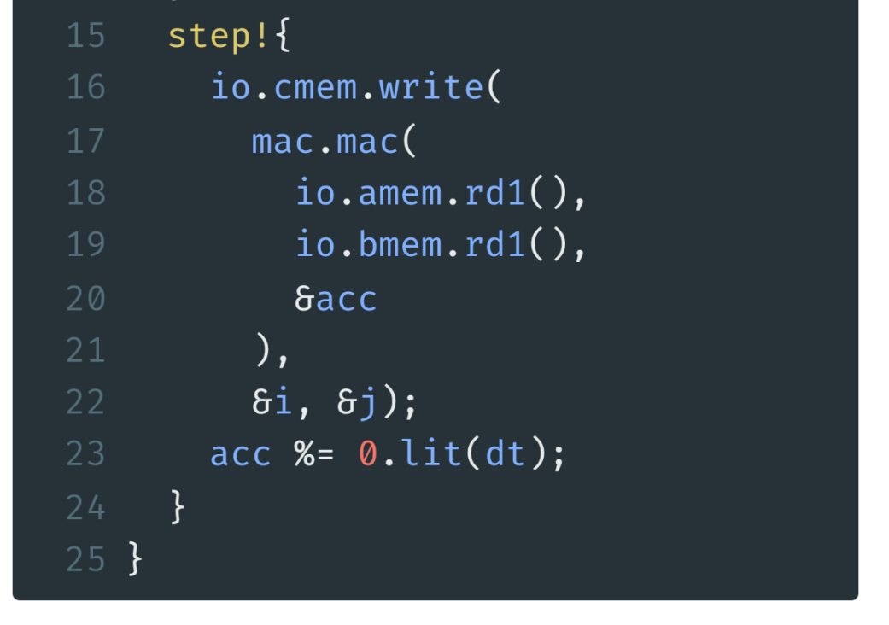
GeMM Example: FSM last step
for i in 0..n
for j in 0..n
Seq
step0
step1
step2
step3
$$⋯$$
step n
$$⋮$$
amem.rd0
amem.rd0
amem.rd0
amem.rd0
write to cmem
bmem.rd1
bmem.rd1
bmem.rd1
bmem.rd1
last mem read and MAC
amem.rd1
amem.rd1
amem.rd1
amem.rd1
bmem.rd1
bmem.rd1
bmem.rd1
bmem.rd1
mac
mac
mac
mac
acc
acc
acc
acc
cmem.write
./crates/cmtc/examples/gemm.rs line 38-97

Slide 37
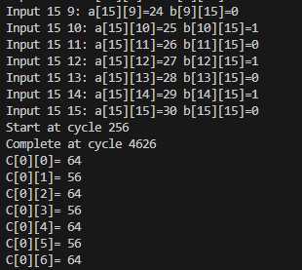
GeMM Example: Simulation
cd /root/cmt2
cargo run –-example gemm
cd ./tb/gemm_ksim
make all
./GEMM_s16_i8
4370
Commands to run simulation
Expected results
Cycles= ($(16+1)$ //k
$×16+1)$ //j
$×16+1$ //i
= 4369
+ 1 cycle to init
+ 1 cycle to init
+ 1 cycle to write finish

Slide 38
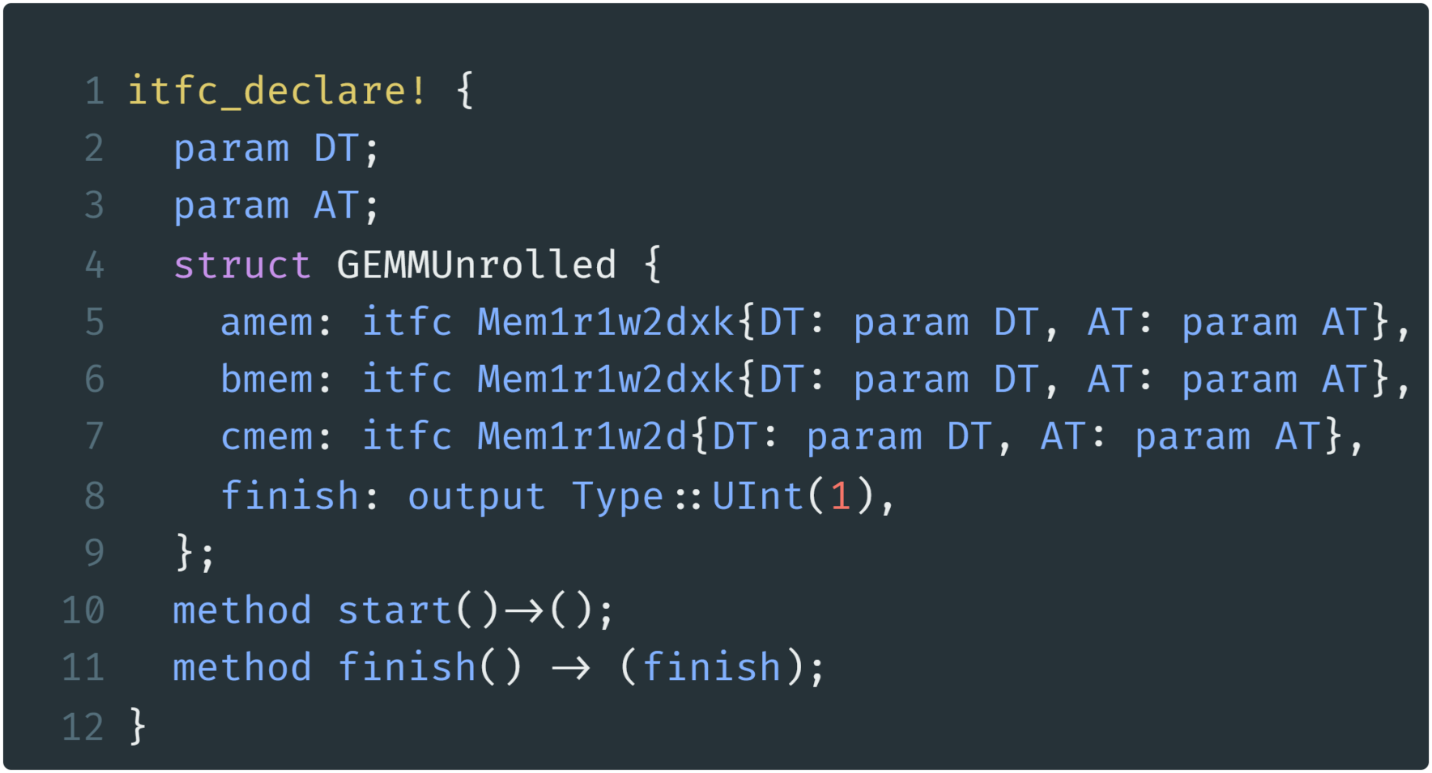
GeMM unrolled Example: Interface Declare
Mem
Mem
Mem
Mem
GEMM
Unrolled
Multi-bank 2D memory
Mem
MAC
MAC
MAC
MAC
Mem
Mem
Mem
$$+$$
FSM
C Mem
./crates/cmtc/examples/gemm_unrolled.rs line 25-36

Slide 39
GeMM unrolled Example: unroll factor
Iter 1
Iter 2
Iter 3
Iter 4
A
unroll factor=4
B
C

Slide 40
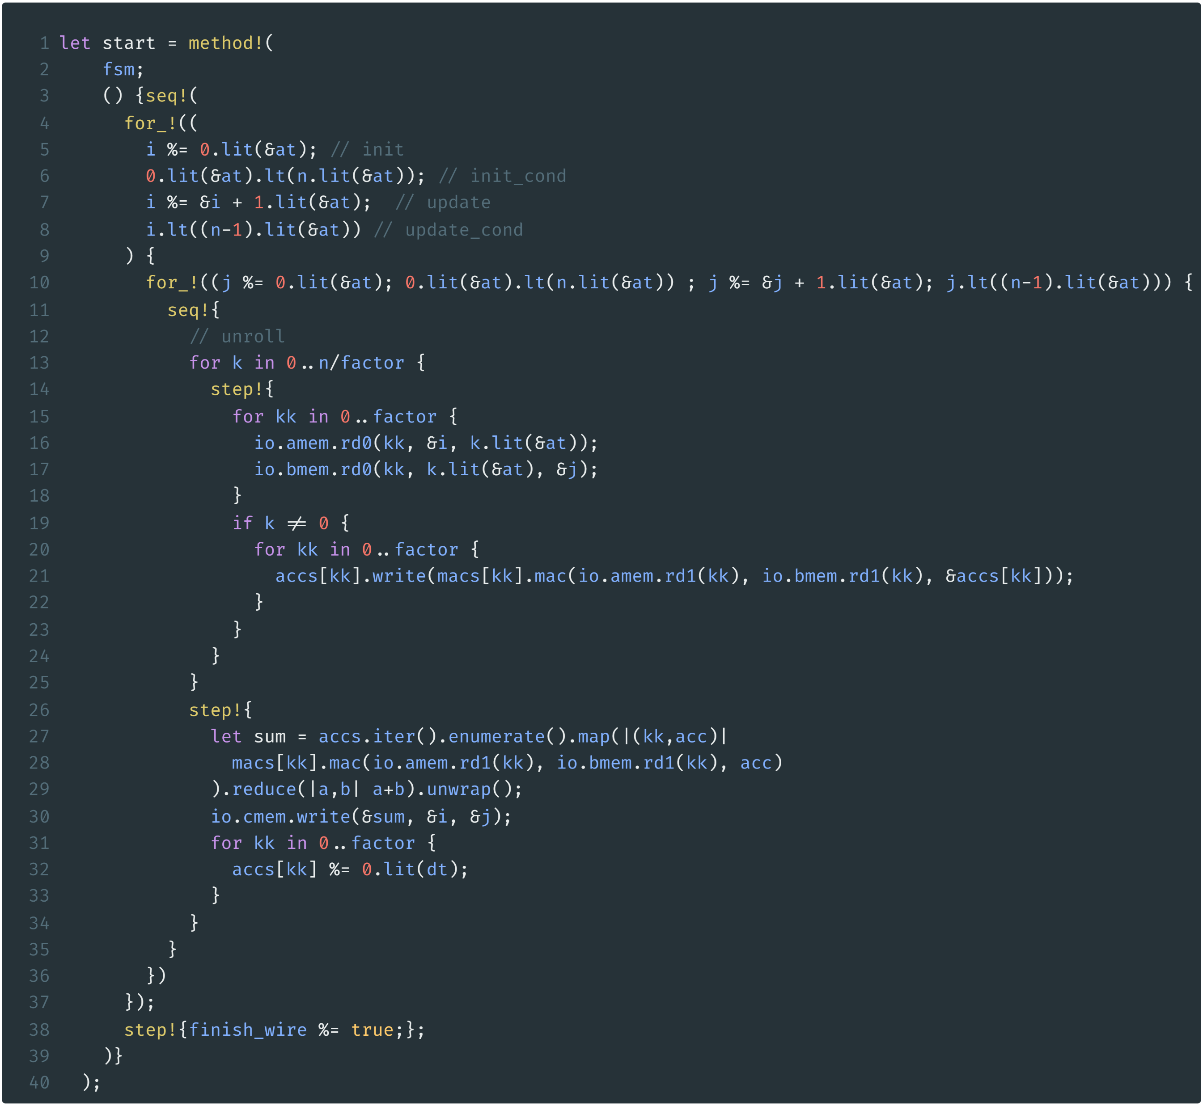
GeMM unrolled Example
i
j
k
./crates/cmtc/examples/gemm_unrolled.rs
line 38-114

Slide 41
GeMM unrolled Example: innermost
for i in 0..n
for j in 0..n
Each inner loop have n/factor+1 steps
read factor memory banks at the same time
invoke factor MACs and accumulate
get the sum of all accumulators
write to c memory
./crates/cmtc/examples/gemm_unrolled.rs
line 38-114

Slide 42
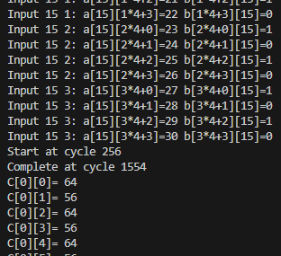
GeMM unrolled Example: Simulation
cd /root/cmt2
cargo run –-example gemm_unrolled
cd ./tb/gemm_unrolled_ksim
make all
./GEMMUnrolled_s16_i8
1298
Commands to run simulation
4370/1298$≈$3.37
Factor=4 results
Cycles= ($(4+1)$ //k
$×16+1)$ //j
$×16+1$ //i
= 1297

Slide 43


We’ve integrated Cement into APS!
Traditional HDL
tedious hardware code
Embedded HDL (eHDL)
design hardware in advanced programming language (Scala, Python)
HLS: design hardware in C/C++
①
③
Rust-embedded HDL
software-like control description
Migration for APS integration
circt-cmt2
Cement (cmt2!)
Cement (cmt1)
published at FPGA’24
②
Keep evolving…
rule-based design
Youwei Xiao, Zizhang Luo, Kexing Zhou, and Yun Liang. 2024. Cement: Streamlining FPGA Hardware Design with Cycle-Deterministic eHDL and Synthesis. FPGA '24. https://doi.org/10.1145/3626202.3637561
High-level HDL: describe hardware as transactions/rules

Slide 44
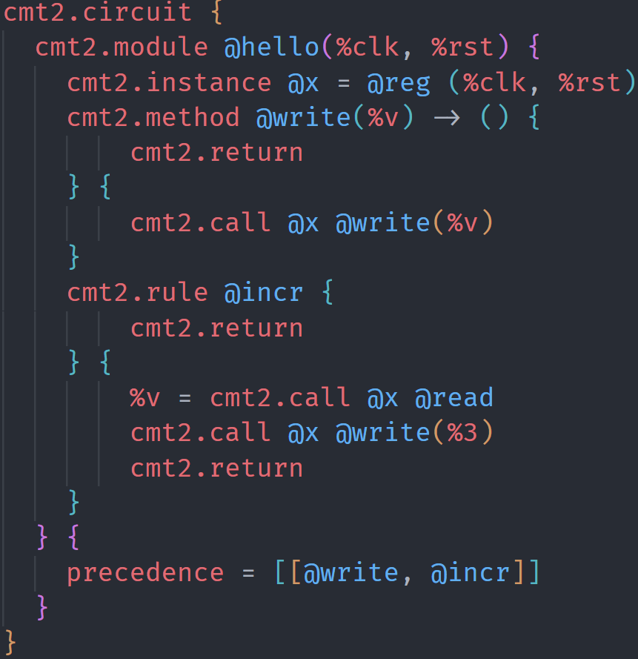
circt-cmt2
We implement cmt2 as a new dialect in CIRCT
MLIR/CIRCT Dialects
Tensor
Linalg
Affine
SCF
Stream
MemRef
Arith
APS
code circt/test/Dialect/Cmt2/hello.mlir
APS synthesis flow
Cmt2
Cmt2ToFIRRTL conversion
FIRRTL
HW
Comb
…

Slide 45
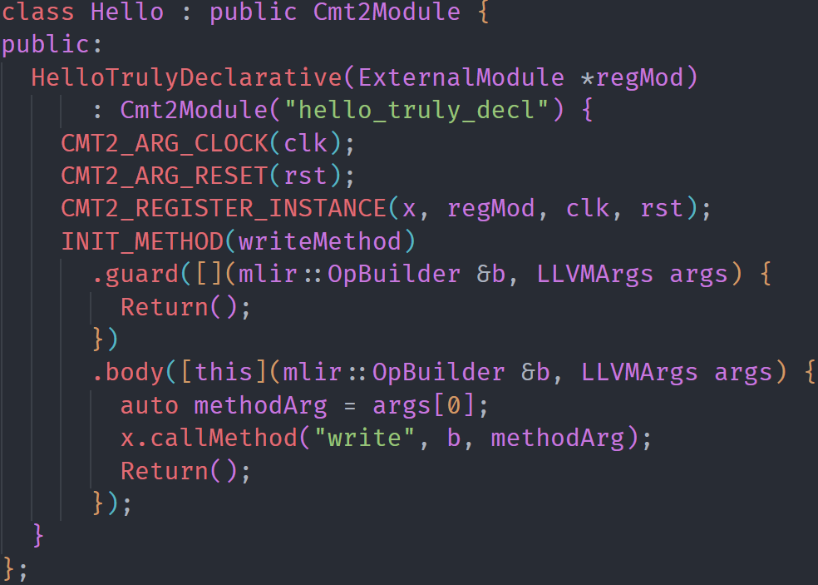
circt-cmt2 EDSL
For productive programming circt-cmt2, we provide a C++-based EDSL. It is used by APS’s synthesizer.
code circt/examples/ECMT2/hello_v3.cpp
construct

Slide 46
Instruction Finding
Domain Applications
Base Processors
Rocket
BOOM
CVA6
CV32E
ISAX MLIR
ISAMORE
APS
Frontend
APS
Synthesizer
Cement CIRCT
Processor
RTL
.cadl
RTL
Cross-level
ISAX Description
APS
Compiler
FPGA
Flow
ASIC Flow
Software
Hardware

Slide 47
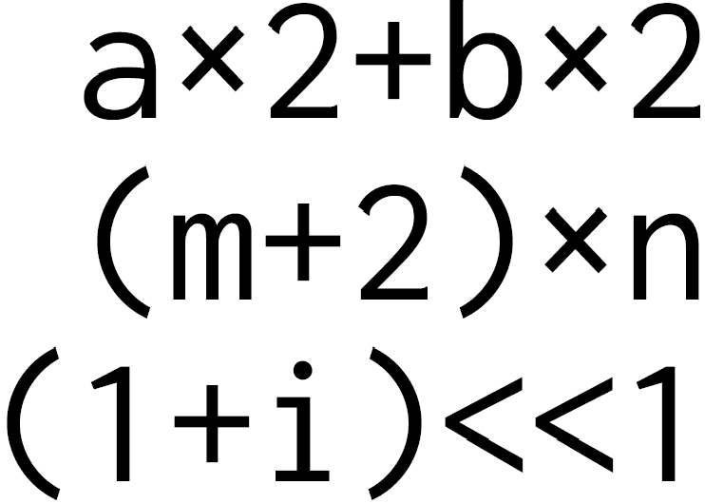
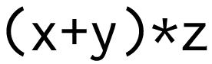
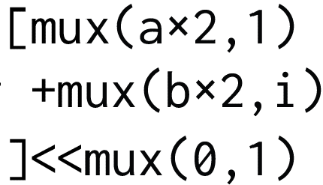
Reusability is a key concern
We should find reusable instructions to customize.
If we have …
Domain Applications
and many other expressions in applications.
A. Multiple custom instructions
Three custom instructions.
C. Semantically reusable instruction
(ideal)
Costly, redundant
B. Syntactic merging: prior work
Ad-hoc
HW-inefficient
General, efficient

Slide 48
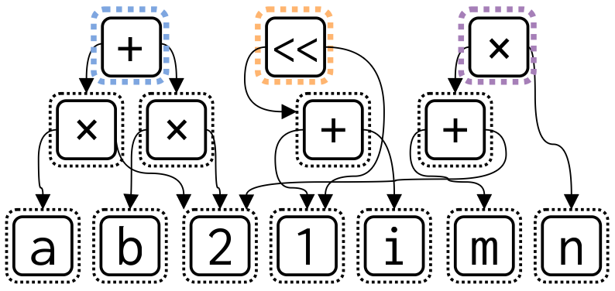
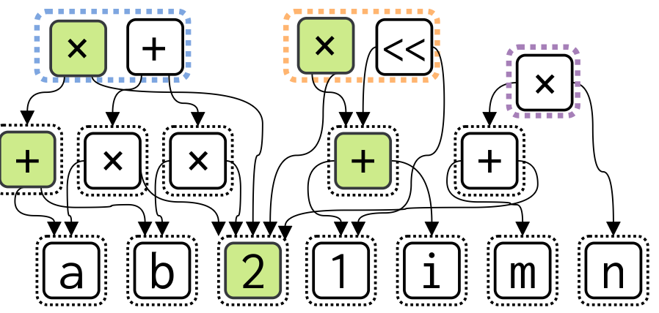
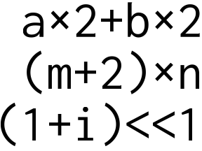
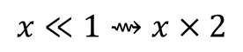
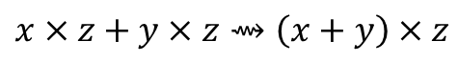
Find Reusable Instructions via E-Graph Anti-Unification
E-graph is a data structure to compactly represent equivalent terms.
E-node: term or subexpression
E-class: contains equivalent e-nodes
$$x×z+y×z⇝\left(x+y\right)×z$$
Initial E-graph
$$x≪1⇝x×2$$
Saturated (partially) E-graph

Slide 49
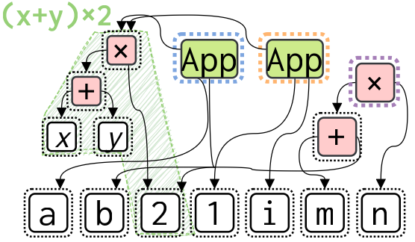
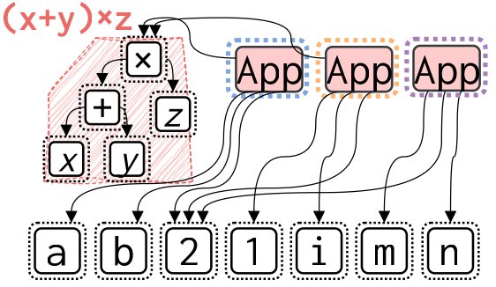
Find Reusable Instructions via E-Graph Anti-Unification
Anti-unification is the process of constructing a generalization common to two given symbolic expressions
Anti-unify
$$\left(3∗b\right) ⨆ \left(a∗2\right)⇝x×y$$
finds common pattern
①
②
① Green terms are found common
② Red terms are found common

Slide 50
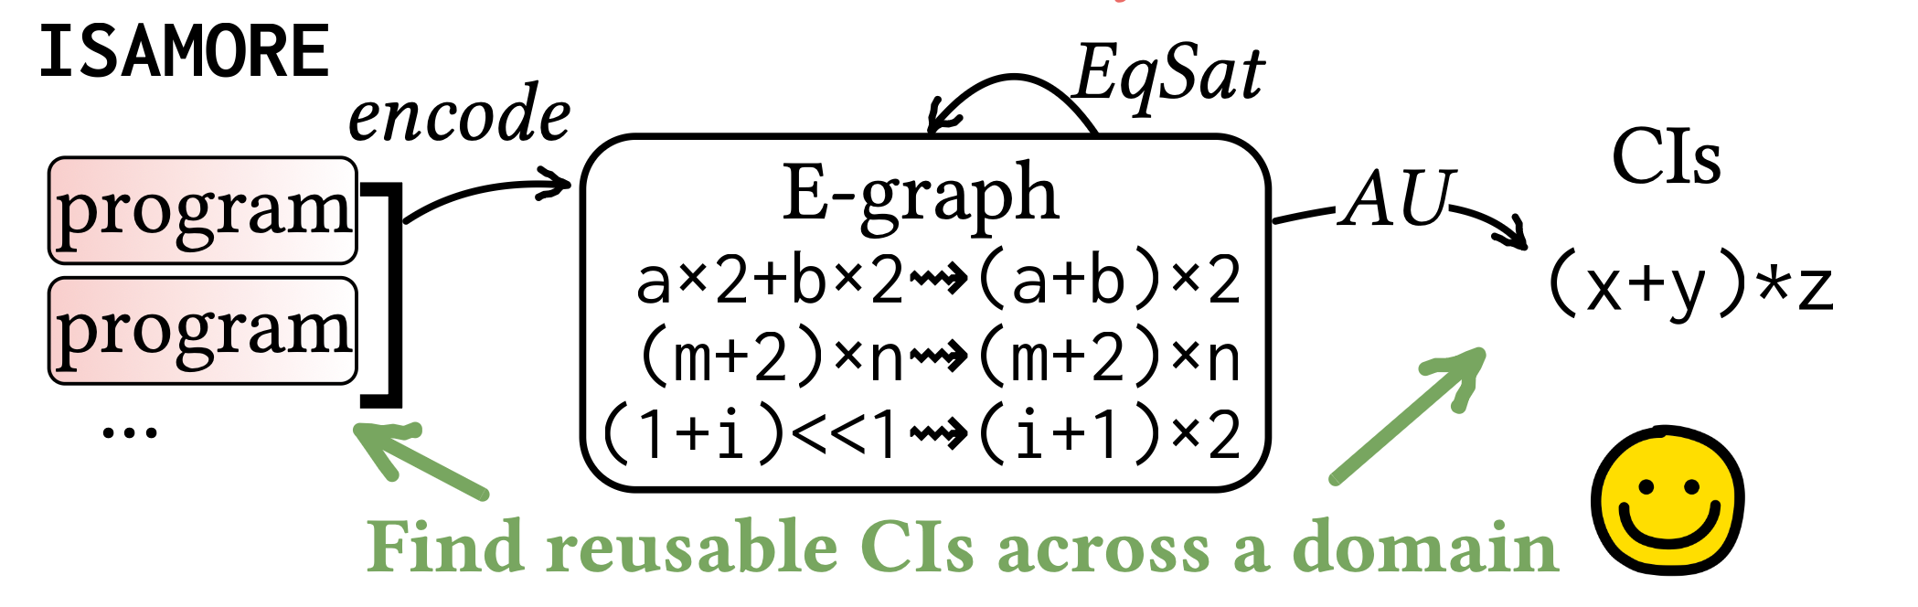
ISAMORE Framework
We’ll present ISAMORE at ASPLOS 2026!
Domain Applications
ISAMORE
.cadl
We are working on ISAMORE’s integration into APS.

